Slide 1

Pavilion RFP
Update
August 19, 2019

Slide 2

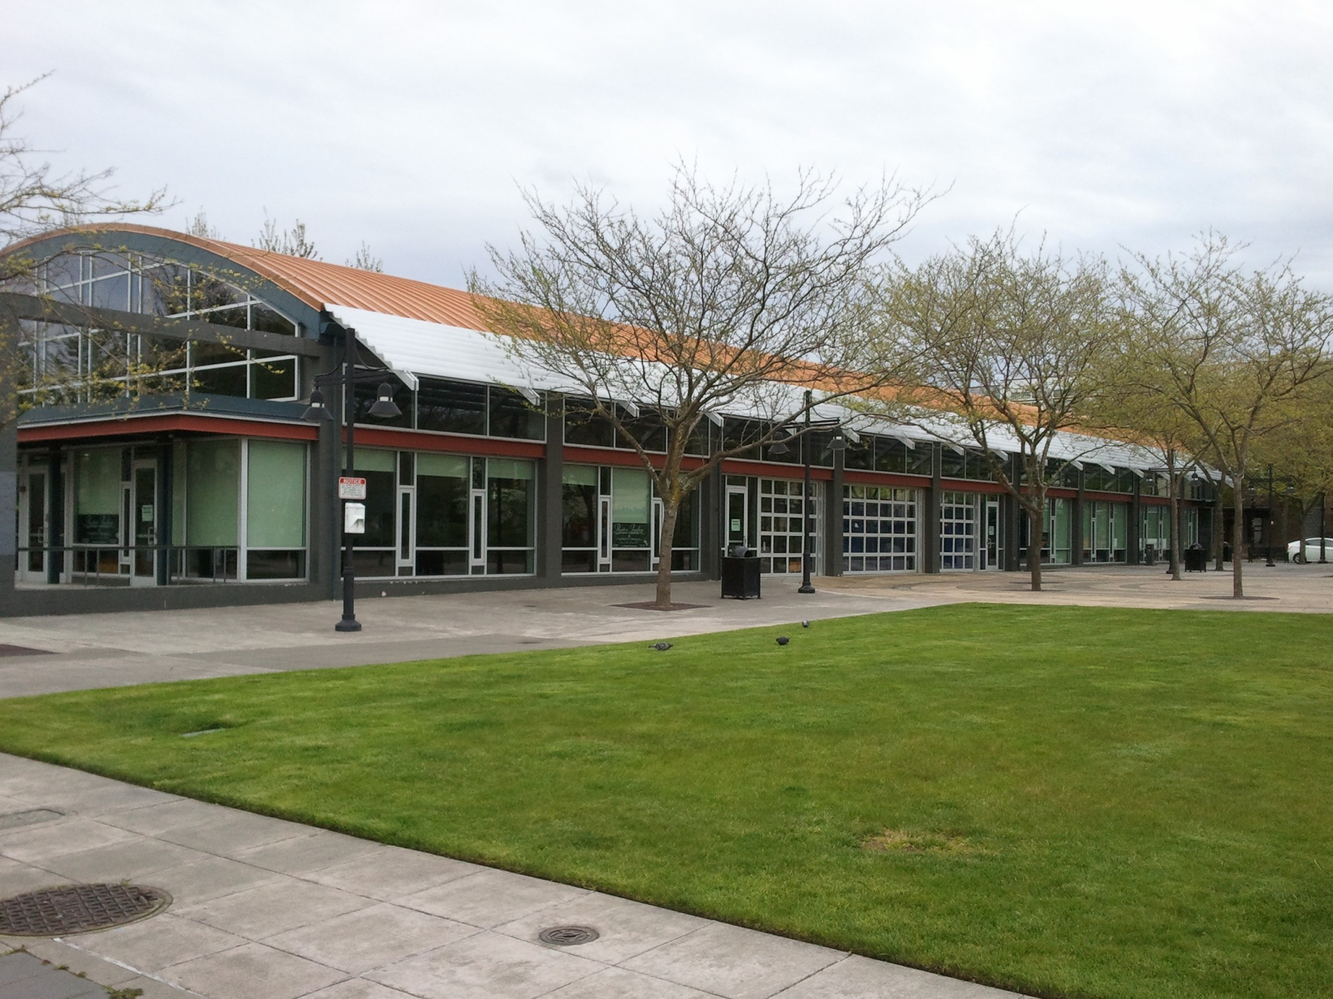
Pavilion
Background - Site
City-owned property updated in 2004
14,770 square foot event center space
Located in the heart of the Downtown Core

Slide 3
Pavilion
Background - COW
COW met to discuss a Pavilion Market Concept on April 15th, 2019
  Points of Discussion:
    History of the site
      Original Building
      2M Rehab
    Uses on the site
    Incorporation of the Big 5 site and Transit Area
COW requested staff gather additional information for a future COW discussion

Slide 4
Pavilion
Background - COW
Staff provided a Downtown Update on June 10th, 2019
  Points of Discussion:
    Downtown Projects
    Public Art
    Pavilion RFP
      Updated COW on submittals
      Notified COW we would return once the Selection Committee made their recommendation

Slide 5
Pavilion
RFP Review Process
RFP issued May 1st, 2019
  To renovate and provide full service management
The RFP was closed on May 31, 2019 and received two proposals.
  The Logan Market
  Pavilion 2.0
Selection Committee:
  Facilities Staff
  Economic Development Staff
  The Farmers Market Staff
Evaluation
  Based upon responsiveness to the City’s stated objectives; the qualifications and capacity of team members; and the proposed concept.
Selection Committee Meetings
  Kickoff Meeting – June 10, 2019
  Scoring Meeting – June 21, 2019

Slide 6
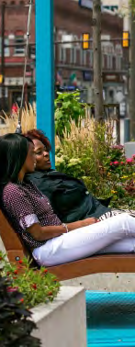
Pavilion
City Objectives
High quality mixed-use development that enhances the character and economic viability of the City
Achieve substantial financial benefit to the City of Renton; both in the short term, through compensation received from a lease of the site, and longer term, whether through various tax revenues or community-building opportunities
Develop positive working relationships with existing organizations and businesses within the downtown core
Qualifications and experience of the developer and their team
Financial ability to complete the project in a timely manner

Slide 7
Summary
of Process
Pavilion
Both respondents delivered very high quality and thoughtful proposals for a development that would intensify and energize this important location.
Both clearly demonstrated the capacity to carry out the redevelopment.
The two proposals offer a vision of a permanent market space, coupled with some level of quality amenities to enhance the overall experience.

Slide 8
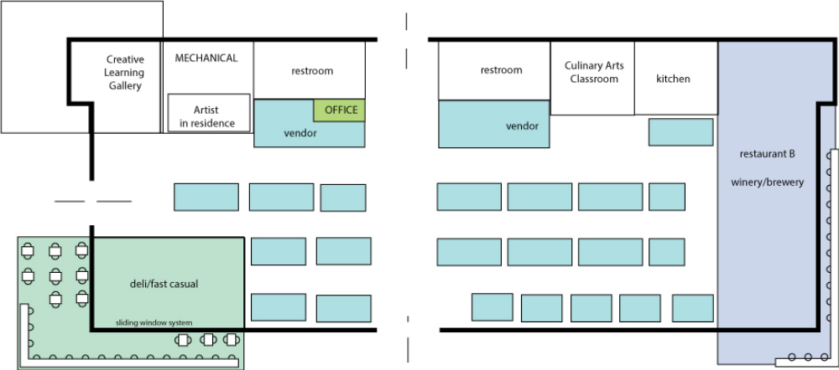
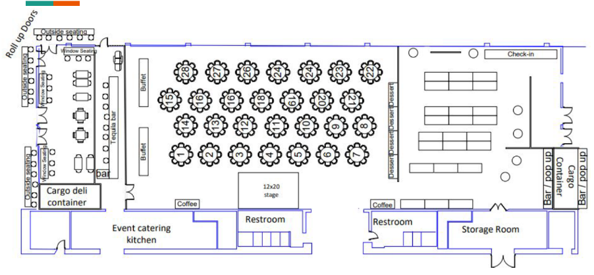
Summary
of Process
Pavilion
The proposals primarily differ in their approach to utilizing the site
Logan Market
Pavilion 2.0

Slide 9
The Logan Market Proposal
Submitted May 31, 2019

Slide 10
Pavilion
Logan Market Team
Team:
Dave Brethauer – Developer, Entrepreneur
  Owner of Cortona Building
  Experience in Retail, Art Curriculum and Commercial Development
Keli Sim – Creative Director
  Cook, Artist, Teacher, Tour Guide and Entrepreneur
  18 years of retail experience
Claudine Rode – Tenant Relations
  20 years experience in the food and hospitality industry
  Previous 4 years spent working in airport restaurant development
David Tilton – Business Development, Entrepreneur
  Born and raised in Renton
  Entrepreneur, Consultant, Business Development, Program Management and Small Business Owner

Slide 11
Pavilion
LM - Market Layout

Slide 12
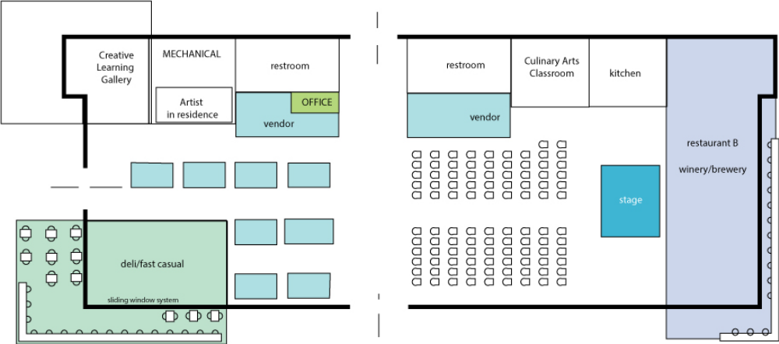
Pavilion
LM - Event Layout

Slide 13
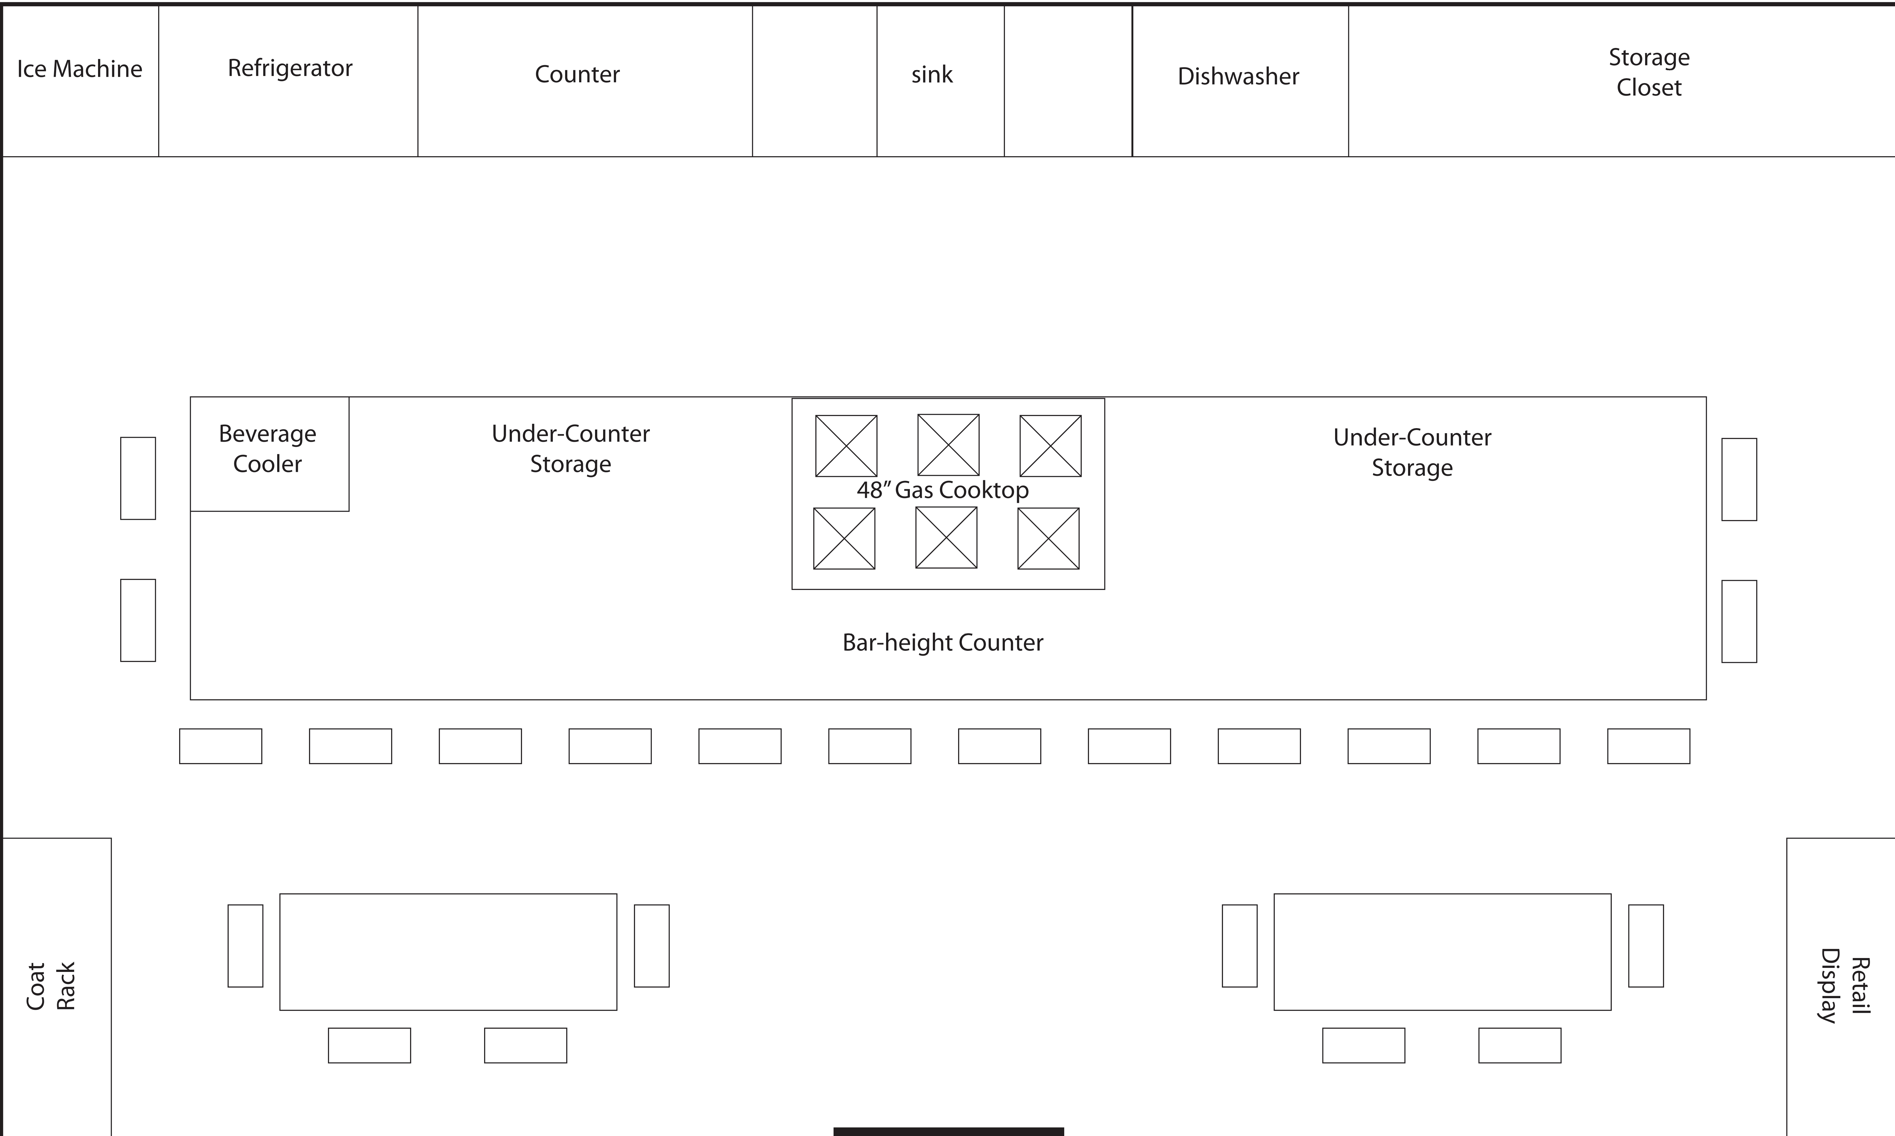
Pavilion
LM – Culinary Arts Classroom

Slide 14
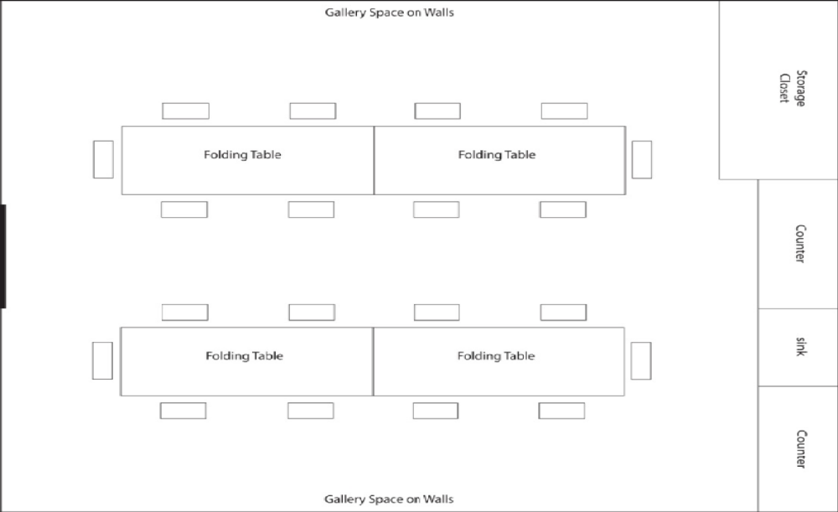
Pavilion
LM – Creative Learning

Slide 15
Pavilion
Logan Market Terms
Terms:
25-year lease with options to renew in 5-year increments
5-years of $1 annual lease terms followed by rate of $10 per square foot per year
Master Lease Authority to enter into and negotiate sub-leases
City’s continued maintenance of the exterior (less tenant seating areas) and piazza
Commitment to coordinate and host public City sponsored events
Free event rental for internal City needs such as seminars or committee meetings and/or community events
First-right-of-refusal on purchase of the building and/or land including the Transit street and vacant gravel lot

Slide 16
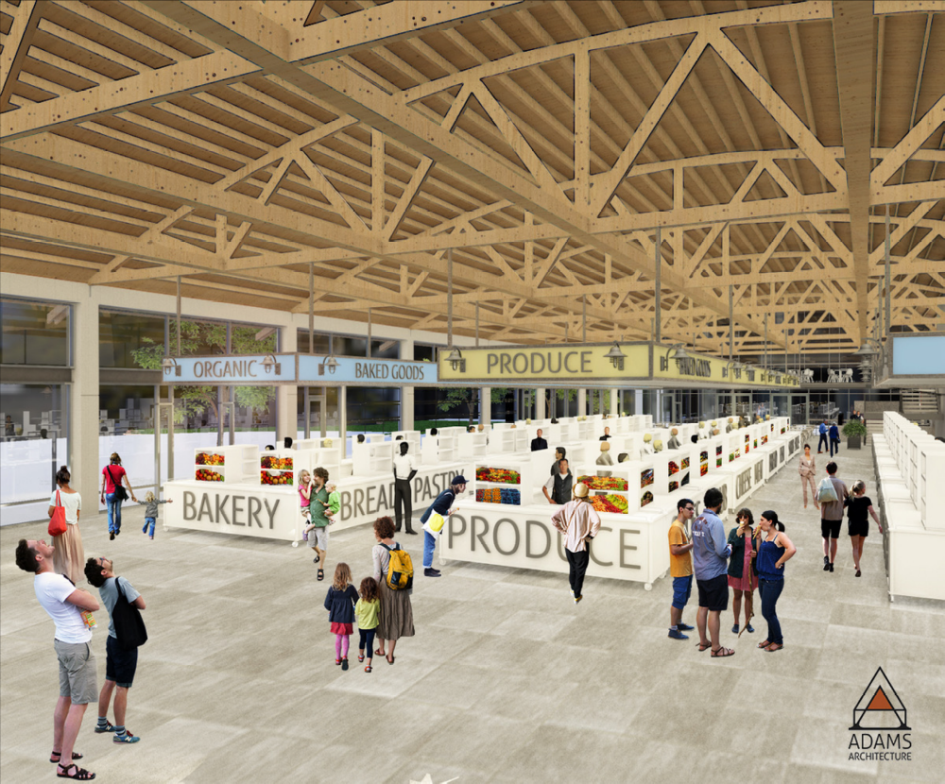
Pavilion
Logan Market Concept

Slide 17
The Pavilion 2.0 Proposal
Submitted May 31, 2019

Slide 18
Pavilion
Pavilion 2.0 Team
Team:
Kenneth Rogers
  Owner of Rain City Catering
  Years of experience operating the current Pavilion

Slide 19
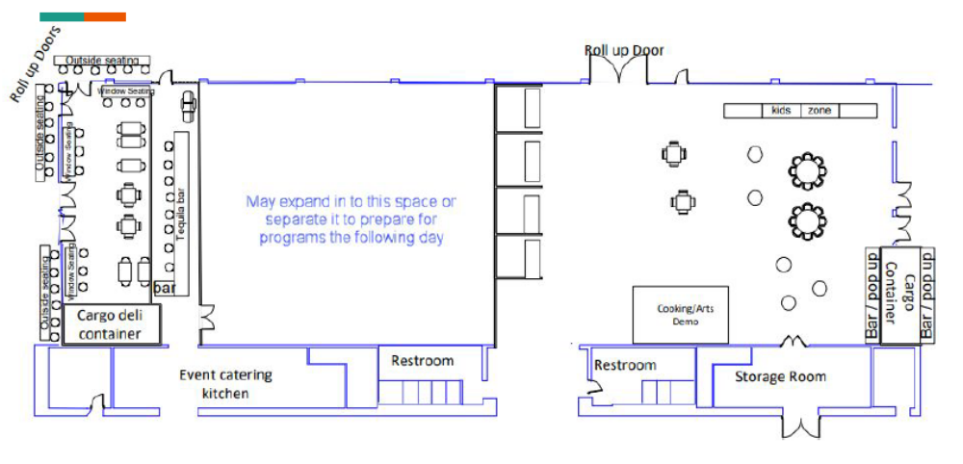
Pavilion
2.0 - Market Layout

Slide 20
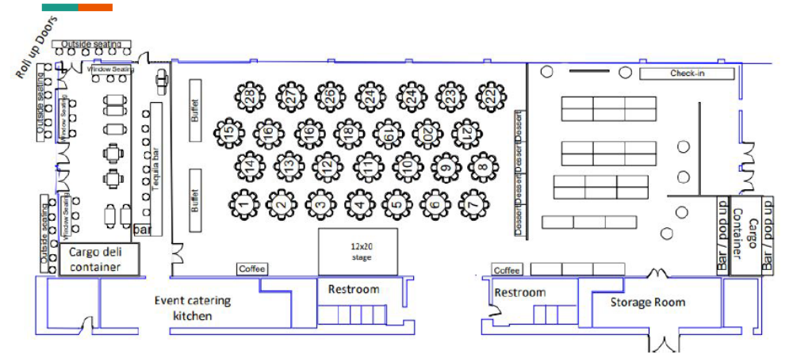
Pavilion
2.0 - Event Layout

Slide 21
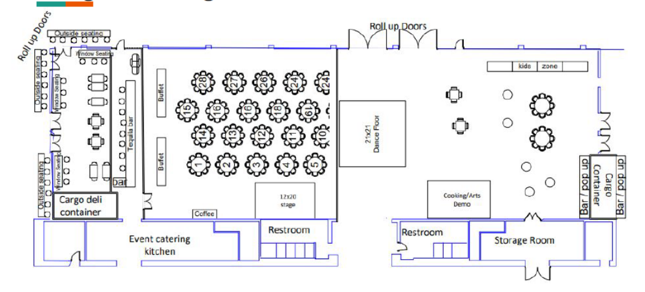
Pavilion
2.0 – Arts, Music & Food Layout

Slide 22
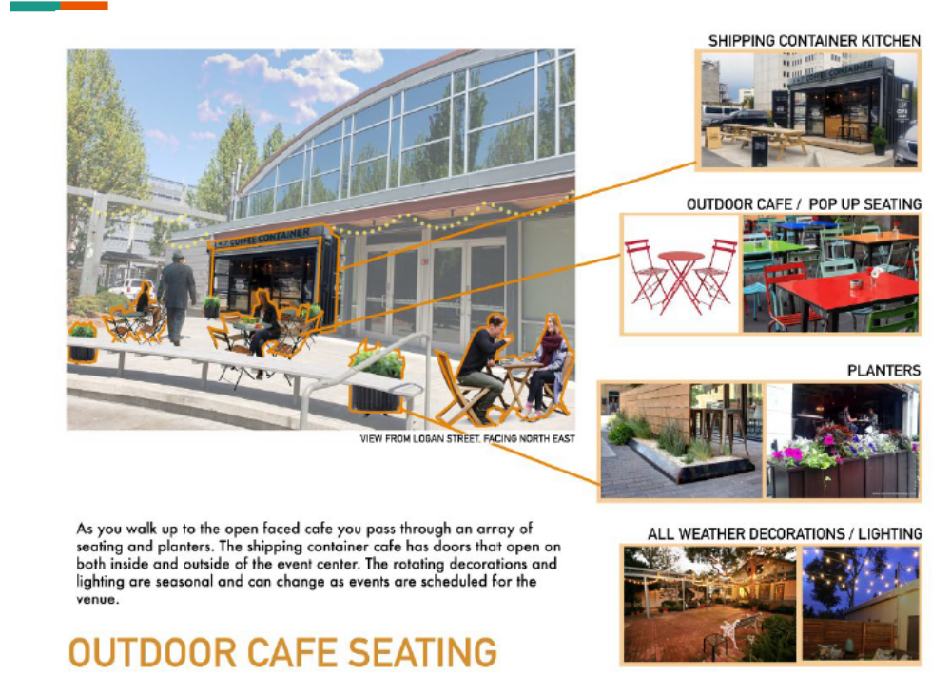
Pavilion
2.0 – Pop-up Business

Slide 23
Pavilion
Pavilion 2.0 Terms
Terms:
15 to 20 year lease
Revenue share percentage with the City

Slide 24
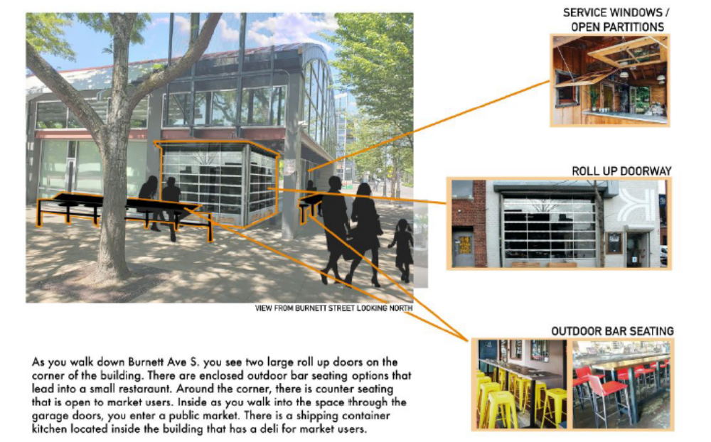
Pavilion
Pavilion 2.0 Concept

Slide 25
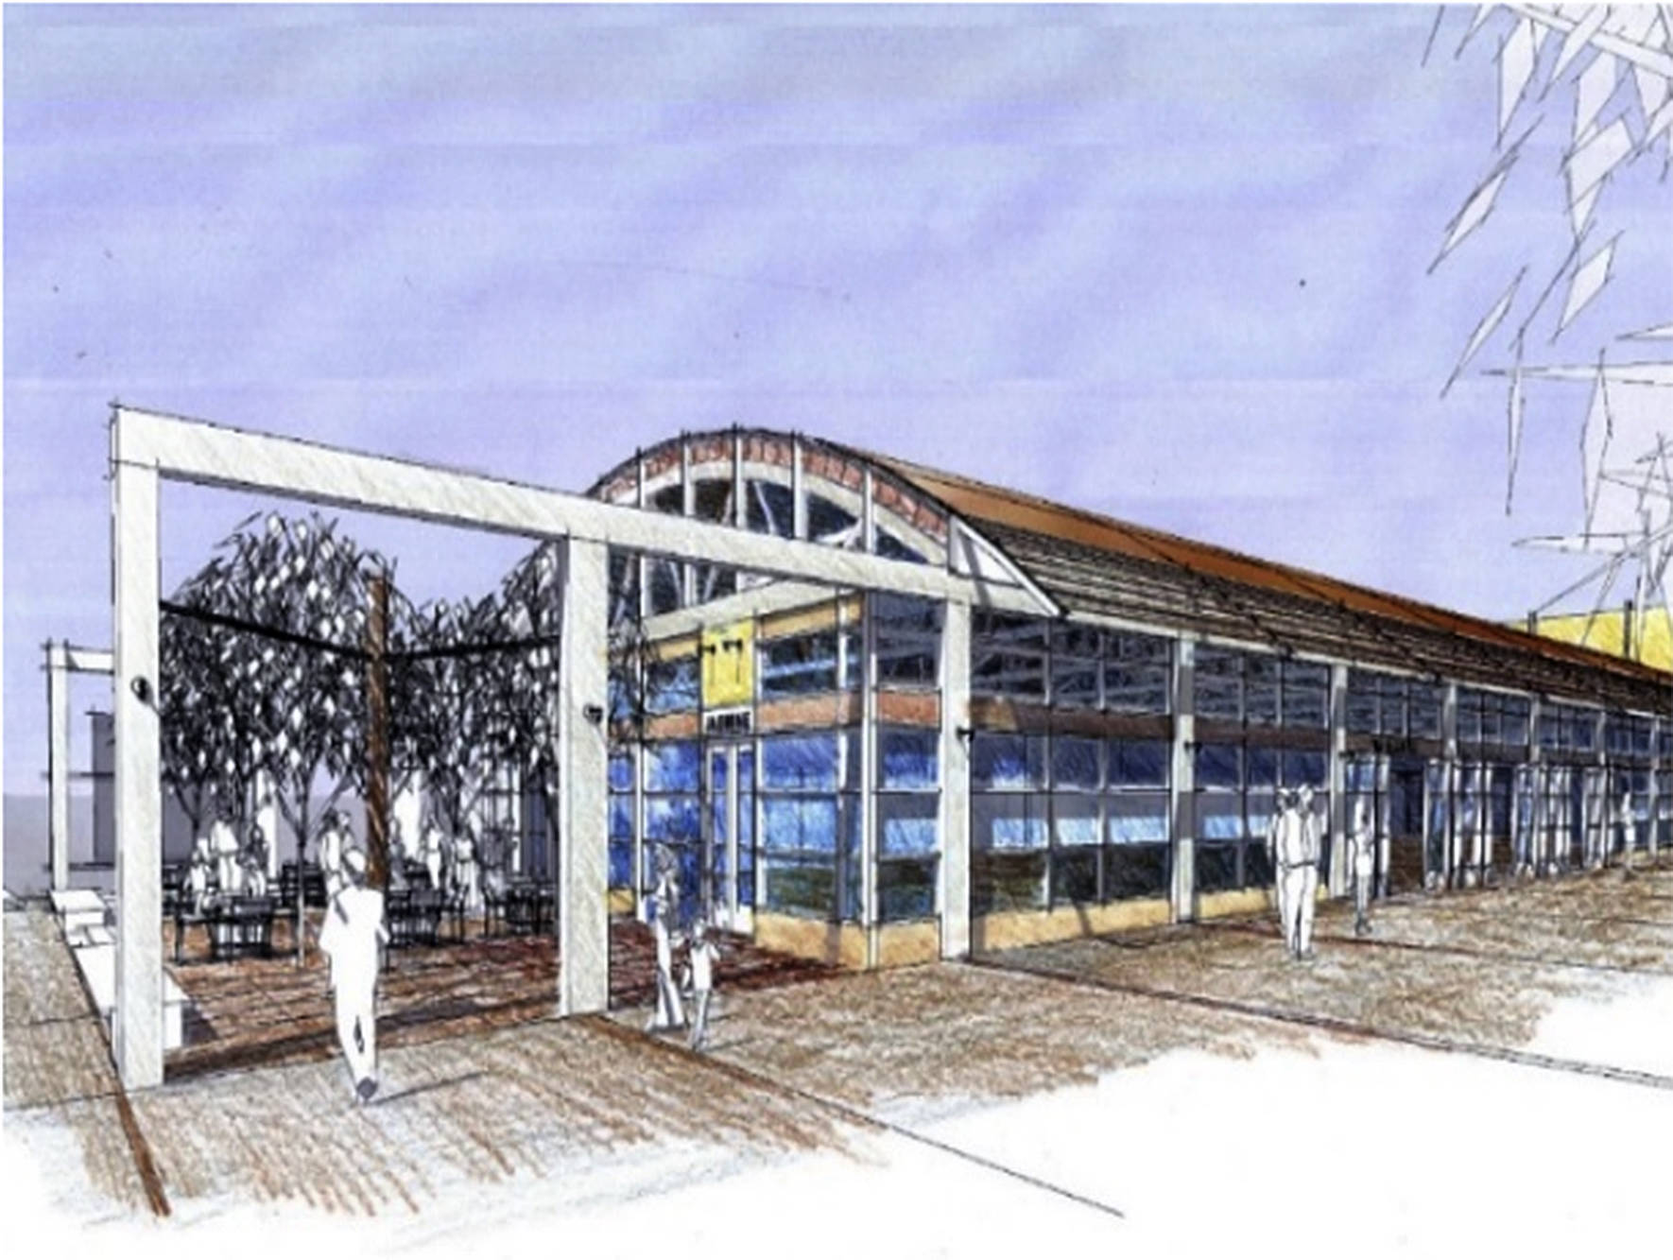
Pavilion
Review Committee Summary
Both concepts address city objectives with a mixed use plan that brings a variety of different uses to the site and creates a more urban center feel.
The Logan Market proposal included a more extensive redevelopment of the site and a higher mix of uses.
The Pavilion 2.0 proposal included a larger event space and open public restrooms.

Slide 26
Pavilion
Selection Criteria
Category | LM | 2.0 | Total Possible
High Quality Development | 9.33 | 6.67 | 10 pts
Financial Benefit to City | 16 | 13 | 20 pts
Develop Positive Working Relationships with exiting organizations | 8.33 | 8.67 | 10 pts
Qualifications and Experience | 33.33 | 26.67 | 40 pts
Financial Ability to complete project | 16 | 16 | 20 pts
TOTALS | 83 | 71 | 100

Slide 27
Review Committee Conclusions

Slide 28
Pavilion
Conclusions
The Review Committee was impressed with caliber of both teams and proposals and believe either would bring greater activity and energize downtown
Both development teams have a demonstrated track record and capacity to deliver
The Pavilion 2.0 proposal shows an evolution of the existing event space that would be a valuable asset to Downtown Renton.
The Logan Market Team proposed a more diverse array of uses that would serve to activate the site and create a sense of place and destination.
The Review Committee ultimate determined that the Logan Market Concept better fit the desired result per the Downtown Civic Core Plan

Slide 29
Pavilion
Questions?

